Slide 1

Amazon Sales Dashboard Report
An overview of key sales metrics and insights
Suraj Kashid
MB25

Slide 2

Objective:
The objective of this dashboard is to provide a comprehensive overview of Amazon sales performance by tracking key sales metrics.
These metrics include Total Revenue, Average Order Value, Unique SKUs, Order Quantity by Month, and Order Fulfillment by Channel.
The dashboard aims to offer actionable insights that can help identify areas for improvement in sales performance, operational efficiency, and customer satisfaction across various product categories and regions.

Slide 3
The metrics selected for this dashboard were chosen because they directly align with the overall business goals:
Revenue Growth: Tracking Total Revenue and Average Order Value helps measure the effectiveness of sales strategies and promotional activities.
Customer Satisfaction: Monitoring the number of orders and fulfillment channels enables us to assess and improve the customer experience, particularly in high-performing regions and categories.
Operational Efficiency: The analysis of Order Fulfillment by Channel and Courier Status ensures that we can optimize shipping processes, reduce delays, and improve inventory management.
By focusing on these metrics, the dashboard provides a data-driven foundation for making informed decisions that enhance overall business performance.

Slide 4

Overview:
The dashboard is designed to track and visualize key sales metrics critical to understanding Amazon’s sales performance. The primary metrics include:
Total Revenue: Captures the overall financial performance.
Average Order Value: Provides insights into customer spending patterns per order.
Unique SKUs: Indicates product diversity and inventory breadth.
Order Fulfillment: Highlights the efficiency of shipping processes across different fulfillment channels.

Slide 5
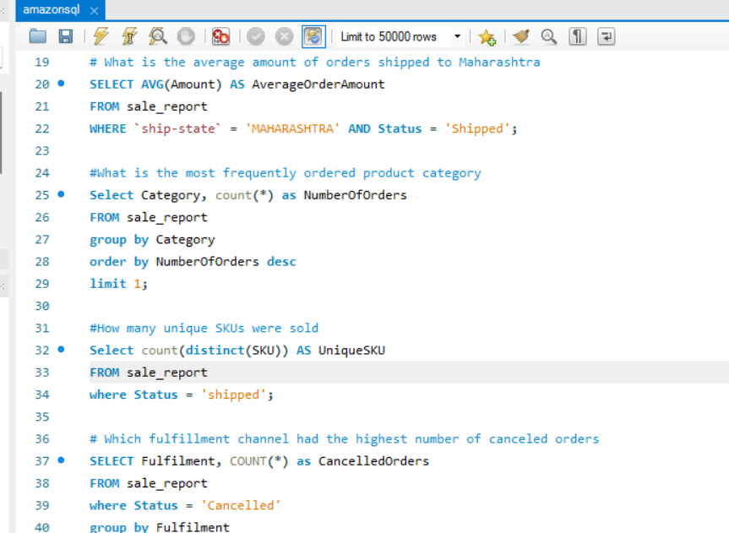
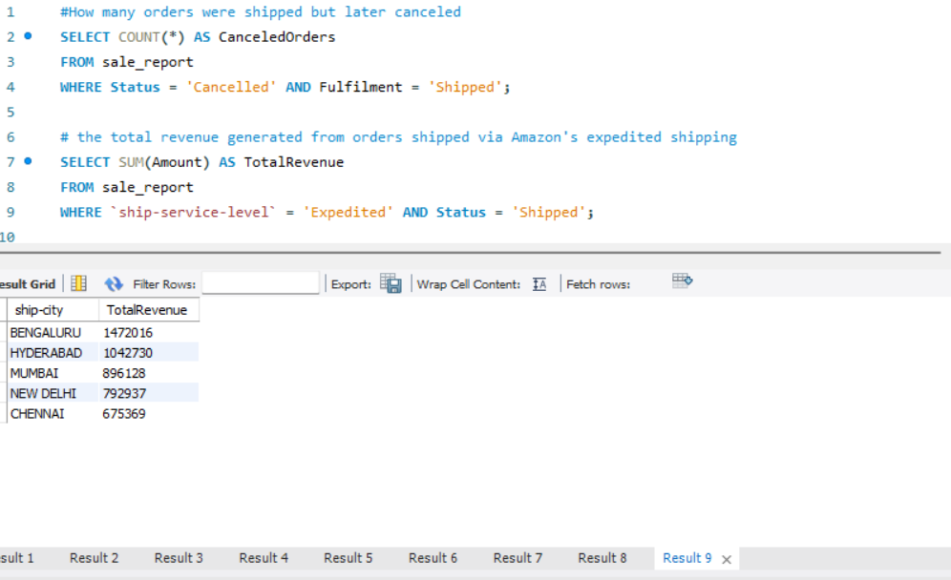

Slide 6
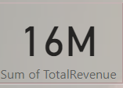
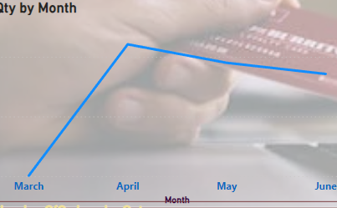

Key Insights and Analysis
Trends and Insights:
Trends: A notable trend is observed with a sharp increase in sales during March, followed by a steady performance in subsequent months.
This spike could be attributed to seasonal promotions, new product launches, or targeted marketing campaigns.
Category Performance: The "Set" and "Kurta" categories contributed significantly to revenue, indicating high consumer demand for these products.
Regional Impact: Major cities like Bengaluru and Hyderabad were key revenue drivers, suggesting strong market penetration in these areas.

Slide 7
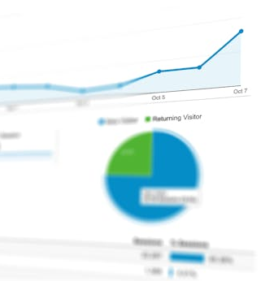
Marketing Strategy: Targeted Promotions: Focus on top-performing cities (e.g., Bengaluru) with customized offers. Product Expansion: Leverage the popularity of high-performing categories by expanding the product range within "Set" and "Kurta.“ Operational Efficiency: Fulfillment Optimization: Increase reliance on the more efficient fulfillment channel (Amazon) to reduce shipping delays. Seasonal Planning: Plan inventory and promotions around the observed peak months
Recommendations for Improvement

Slide 8
Implementation Plan
Short-Term Actions:
Launch city-specific marketing campaigns in top cities.
Rebalance inventory to focus on fast-moving categories.
Long-Term Strategies:
Analyze fulfillment performance monthly to continually optimize shipping times.
Develop a seasonal sales calendar based on historical trends.

Slide 9

Summary and Next Steps
Summary: Reinforce the key insights and how they address the initial challenges. Highlight the recommended strategies.
Next Steps: Outline the next actions to take based on the recommendations, with a focus on monitoring performance and adjusting strategies as needed.

Slide 10
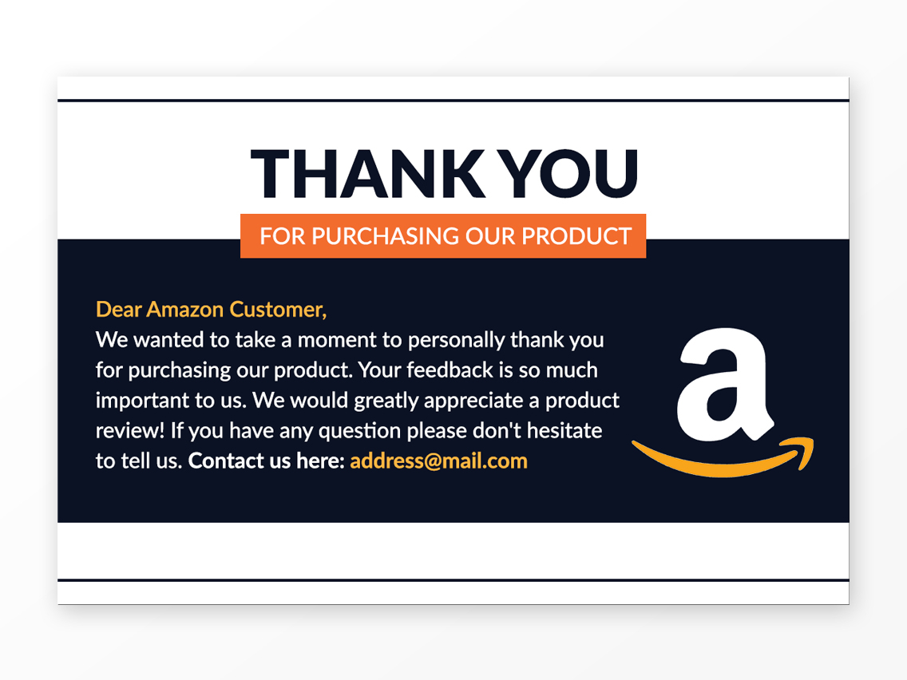
Thank you
Suraj Kashid
MB25

